Slide 1
Welcome To Jukebox
The jukebox we knew was one which plays song and podcast when received coin, kind off like a vending machine. As now time and technology has evolved we no longer need coin to listen a song, rather all we need is user credential to have our day blissful.

Slide 2
Approach to the Project
An ER diagram was created which helped to mapped the table according to our project structure.
By taking the reference of the ER diagram table was created on MySQL
The tables that were created:-
Artist table which have attributes the artistId and Artist Name
Album table which have attributes albumName, albumId and the album ReleasedDate.
PodCasteEpisodes table which have attributes EpisodeId and PodCasteId.
Genre table which have attributes genreId and type of genre.
Songs table which have attributes nameOfTheSong, songId, Duration, albumId and filePath.
PodCaste table which have attributes podcasteId, nameOFThePodCaste episode, languageOFTheEpisode, PodCaster name and filepath.
User table which have attributes userId, username, password and emailId.
PlayListSongDetails table which have attributes detailedId, PlayListCreation and songID.
PlayListPodCasteDetail which have attributes detailedPodCasteId, playlistCreatedOn and PodCasteId.

Slide 3
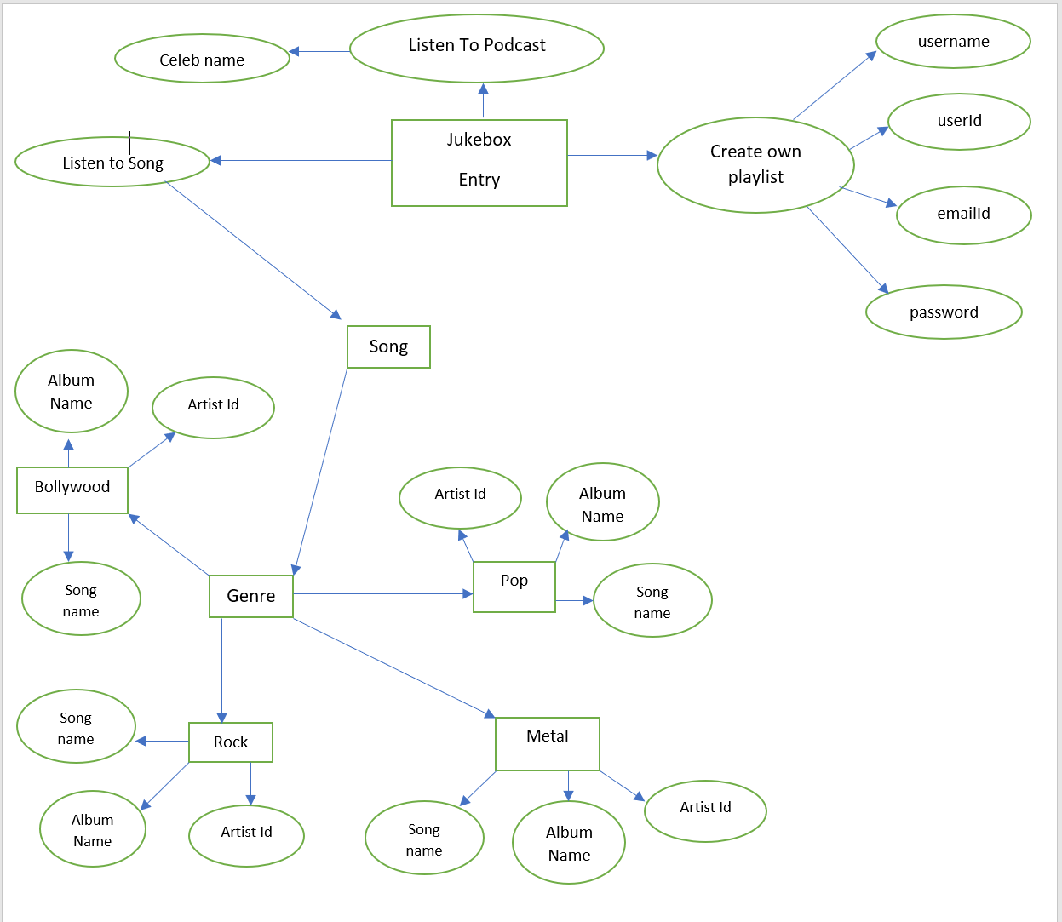
ER Diagram

Slide 4
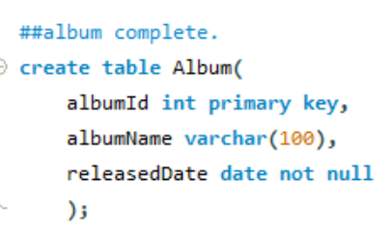
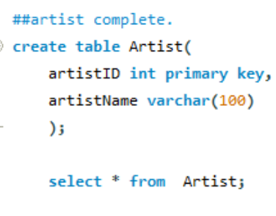
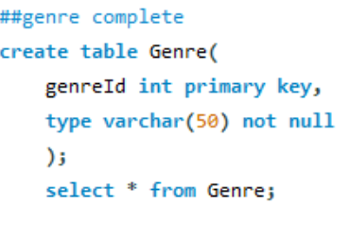
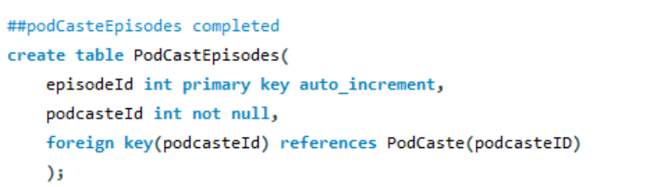
Tables Created
Table Artist
Table Album
Table Genre
Table PodCastEpisodes

Slide 5
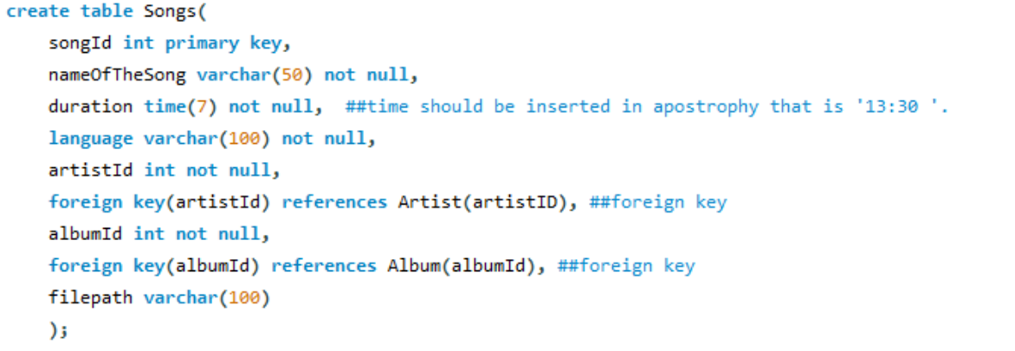
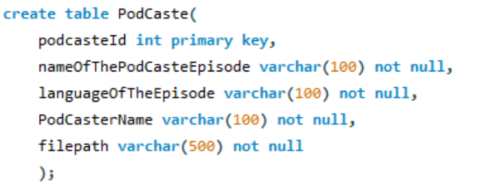
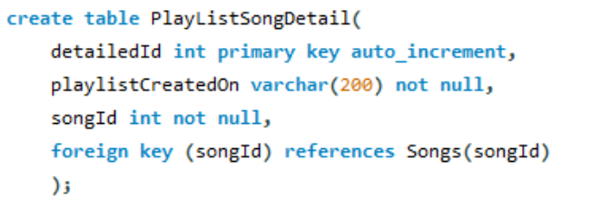
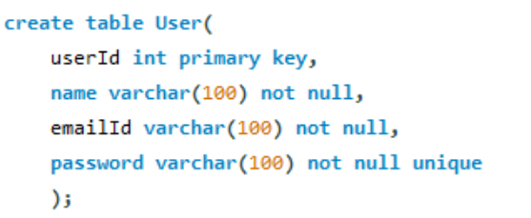
Table Songs
Table Podcast
Table PlaylistSongDetail
Table User

Slide 6
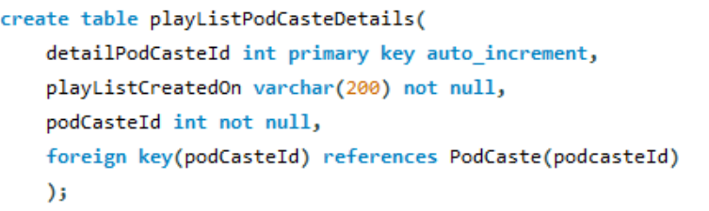
Table PlaylistPodCasteDetails
Flow Of The Program
The user will first enter the jukebox where three options will be given to the user:-
Listen to Song
Listen to PodCaste
Create your own Paylist.
The flow of the above structure is displayed below::
If the user want to listen to Song
He/she will be provided option to select Genre of his choice. The genres are
1.Rock
2. Pop
3. Metal
4. Bollywood
Upon selecting any of the Genres mentioned, the user will be taken to the Select Artist choice where he/she will be Given option to choose Artist of their liking.
After selecting Artist of their choice the user will be then directed to album choice thereafter song selection. Which, thereafter his/her favourite song shall be played.
Listen to Song

Slide 7
If the User wants to listen to podcast.
He she will be directed to Podcast page where he/she will be asked to choose their favourite podcaster given in the list as Podcaster name
After selecting the said Podcaster name their favourite podcaster podcast shall be played.
Listen to Podcast

Slide 8
If the user wants to create a playlist of their own may it be podcast/song playlist.
Create Playlist of your own.
The user will be asked to enter his userId and user Password which is stored in the user table. Where the asked credential will be matched with the existing data in the said table then he/she will be proceeded further else the user can’t create playlist of its own.
If Song,
then user will be asked to enter the songId where it will get matched with the existing songId data in Songs table and if matched the SongId will get stored in the PlayListSongDetails table.
Same goes with
If Podcast.
If matched
The user will be asked whether he/she is an existing customer or not.
If yes
If no next slide

Slide 9
If not an existing customer
The user will be asked the following credentials::
To create username
To create userId
To create an emailID
To create password.
The asked credential is validated by using regex. If each credential satisfies the regex condition then the credential will be updated to the user table else the user will be provided 5 chance. Which if exhausted the program must be run again from the start.
The user then will be welcomed by the jukebox to create playlist of their own where the choice to create song playlist and podcast playlist will be given. And, thereafter he/she can gladly enjoy the created playlist.
If accepted

Slide 10
Purpose met::
ER diagram created.
Listen to Song program created.
Listen to podcast program created.
Giving user ability to create playlist of their own created.
For validation of UserName, Password, UserId and EmailId regex was used.
Program made on concept of OOPs.
Used File handling to read File path of the song and the podcast. Exception was handled.
Mysql was used to retrieve and update data using JDBC.
CRUD operation was implemented using JDBC.
Loops Used :: doWhile and while.
Conditions used :: Switch, if, nested-if and if-else.
Predicate Interface used.
Purpose not met::
Java 8 collections not used.
Java 8 functional Interfaces consumer, supplier and Function not used.
Java 8 stream API not used.
Junit testing not done.

